Slide 1
SKYSHIELD
REAL-TIME DRONE
COLLISION DETECTION
& AIRSPACE MONITORING
DSA-2 CAPSTONE PROJECT
Geometric Data Structures + Computational Geometry
J. Trinesh — CH.SC.U4AIE25022
V. Srikar — CH.SC.U4AIE25054
Tridev Badari.R— CH.SC.U4AIE25069
K. Rudheer — CH.SC.U4AIE25074
DSA – 2
Course Code: 22AIE203
Department: CSE (AI)
Faculty / Project Guide: Dr.G.Bharati Mohan
Academic Year: 2025-2029
B.Tech CSE (AI) | Academic Year 2026

Slide 2
Project Overview
02
SKYSHIELD — Real-Time Drone Collision Detection & Airspace Monitoring
1
BRIEF INTRODUCTION
2
APPLICATION DOMAIN
SKYSHIELD is a DSA-based monitoring system that tracks drone movement in 3D airspace, detects potential drone collisions, and identifies no-fly-zone violations.
Drone airspace management and autonomous aerial systems, with a focus on spatial data structures, geometric search, collision detection, and real-time monitoring.
3
BACKGROUND OF THE PROBLEM
4
IMPORTANCE OF THE PROBLEM
Multiple drones can operate simultaneously and change position continuously. Checking every drone pair repeatedly creates unnecessary comparisons as the fleet grows.
A missed proximity conflict can lead to collisions, mission failure, equipment damage, or unsafe airspace usage. Fast spatial detection is therefore important for coordinated drone operation.
05 NEED FOR THE PROPOSED SYSTEM
The proposed system uses spatial data structures and algorithms to reduce unnecessary searches, support nearest-neighbor and range queries, and provide efficient collision and restricted-zone detection.
REAL-TIME DRONE AIRSPACE MONITORING • DSA-2 CAPSTONE
SKYSHIELD

Slide 3
Existing System
03
Current method used to handle drone tracking and collision monitoring
1
EXISTING APPROACH / SYSTEM
2
CURRENT METHOD
The existing approach stores drone records and checks drone proximity through broad scanning. Potentially interacting drones are evaluated using distance calculations.
1. Store drone information
2. Examine candidate drone pairs
3. Calculate 3D Euclidean distance
4. Raise an alert when the collision threshold is reached
3
EXISTING TECHNOLOGIES / TECHNIQUES
4
CURRENT DATA PROCESSING / MANAGEMENT
• General-purpose data collection
• 3D Euclidean distance
• Pairwise / broad scanning
• Distance-threshold collision detection
Drone data is maintained as individual records and processed through repeated proximity checks. The approach does not use a spatial index to organize nearby locations before searching.
CURRENT WORKFLOW
DRONE DATA
DISTANCE
DECISION
ALERT
01
SCAN
02
03
04
05
Position + velocity
Candidate pairs
3D calculation
Threshold check
Collision risk
REAL-TIME DRONE AIRSPACE MONITORING • DSA-2 CAPSTONE
SKYSHIELD

Slide 4
Existing System Limitations
04
Why broad scanning becomes inefficient as the drone population grows
Existing approach: general-purpose storage + broad scanning + direct distance checks
1
TIME INEFFICIENCY
2
SPACE REQUIREMENTS
3
SEARCH / RETRIEVAL
Pairwise collision checks can examine O(n²) drone pairs, so processing grows rapidly with fleet size.
Storing drone records is O(n). A broad-scan approach does not provide a spatial index to organize nearby points.
Without spatial indexing, irrelevant drones are still examined. There is no efficient spatial pruning.
4
SCALABILITY
5
INSERT / DELETE / UPDATE
6
REAL-TIME PROCESSING
As more drones enter the airspace, the number of comparisons and processing load increases, reducing scalability.
Frequent movement changes spatial relationships. Repeated updates make broad scans costly when the fleet changes continuously.
Repeated full scans can increase latency and make timely collision alerts harder as the fleet becomes larger.
CORE LIMITATION
The existing approach checks too many non-relevant drones. A spatially aware design is required to reduce unnecessary comparisons while supporting dynamic monitoring.
REAL-TIME DRONE AIRSPACE MONITORING • DSA-2 CAPSTONE
SKYSHIELD

Slide 5
Problem Statement & Objectives
05
PROBLEM STATEMENT
Drone fleets move continuously through 3D airspace. The system must detect nearby-drone collisions and no-fly-zone violations while supporting fast spatial queries as the number of drones increases.
COMPUTATIONAL CHALLENGE
EXPECTED OUTCOME
A naïve system checks many drone pairs, giving O(n²) collision-check growth. The challenge is to reduce unnecessary spatial comparisons using appropriate data structures.
A functional monitoring prototype that updates drone trajectories, finds nearby drones, performs 2D range queries, detects collisions, and flags restricted-airspace violations.
OBJECTIVES
01
Dynamic tracking
02
3D nearest search
03
2D range search
04
Collision detection
05
Efficiency
Store, insert, remove and update drone records efficiently.
Implement a KD-Tree to find the nearest drone using spatial pruning.
Implement a Quad Tree to localize drones within a selected region.
Use a Sweep Line broad phase followed by exact 3D distance checking.
Analyze complexity and reduce unnecessary comparisons for larger drone sets.
GOAL → Efficient spatial queries + timely collision / no-fly-zone alerts as drone population grows.
REAL-TIME DRONE AIRSPACE MONITORING • DSA-2 CAPSTONE
SKYSHIELD

Slide 6
Selected Data Structures & Algorithms
06
Each structure is mapped to a specific spatial operation
Component
Type
Major operation
Role
HashMap
Map
put / remove / lookup
Drone ID management
KD-Tree
3D tree
nearest neighbor
Fast 3D proximity search
Quad Tree
2D tree
range query
Localized spatial lookup
Sweep Line
Algorithm
broad-phase collision
Reduce candidate pairs
ArrayList
Dynamic list
store / iterate
Drone & active-set storage
ALGORITHMS
01
KD-Tree — Nearest Neighbor
02
Quad Tree — Range Query
Finds the closest drone in 3D space by splitting points along X, Y and Z axes and pruning distant branches.
Divides the 2D airspace into regions and searches only the regions that intersect the query area.
03
Sweep Line — Collision Detection
04
Euclidean 3D Distance
Sorts drones by X-position, maintains active candidates, checks Y-overlap, then confirms collision using 3D distance.
Calculates the exact distance between two 3D points for collision and no-fly-zone validation.
REAL-TIME DRONE AIRSPACE MONITORING • DSA-2 CAPSTONE
SKYSHIELD

Slide 7
Why These Data Structures & Algorithms?
07
DSA selection based on the project's required operations
KEY IDEA: Each DSA is chosen for the spatial operation it handles best.
Requirement
Required operation
Selected DSA
Why it fits
Problem requirements
Track drones, detect collisions, check restricted airspace
HashMap + KD-Tree + Quad Tree + Sweep Line
Covers ID management, spatial search and collision detection.
Required operations
Insert / remove / lookup; nearest; range; collision filtering
HashMap + KD-Tree + Quad Tree + Sweep Line
Each operation is mapped to a dedicated structure / algorithm.
Suitability of selected DSA
3D point search + 2D region search + collision broad phase
KD-Tree + Quad Tree + Sweep Line
Matches the geometry of the actual query.
Alternative DSA / algorithms
Brute-force pairs; HashMap alone; one structure for all tasks
Brute force / HashMap
Simpler options exist, but they are not spatially specialized.
Reason for selecting proposed approach
Reduce unnecessary spatial comparisons
Query-specific spatial indexing
Locality allows irrelevant points to be pruned or avoided.
Expected computational advantage
Scale better than checking every pair
Spatial indexing + broad phase
Naïve collision checking is O(n²); targeted searches can reduce work.
REAL-TIME DRONE AIRSPACE MONITORING • DSA-2 CAPSTONE
SKYSHIELD

Slide 8
Proposed Methodology
08
End-to-end monitoring workflow
1 Input
2 Store
3 Index
4 Update
ID, position,
velocity
HashMap
records
KD-Tree +
Quad Tree
Advance by
Δt
5 Query
6 Detect
7 Validate
8 Alert
Nearest /
range
Sweep Line +
distance
No-fly-zone
check
Collision /
zone alert
Continuous loop: update → query → detect → alert → repeat
REAL-TIME DRONE AIRSPACE MONITORING • DSA-2 CAPSTONE
SKYSHIELD

Slide 9
Algorithm & Pseudocode
09
Core algorithm: 3D KD-Tree nearest-neighbor search
PURPOSE
INPUT
OUTPUT
Return the closest drone to target (tx,ty,tz).
KD-Tree root + target coordinates.
Nearest Drone, or null if empty.
Nearest(node, target):
if node == null: return
d = distance3D(node.drone, target)
if d < bestDist:
bestDist = d
bestNode = node.drone
choose near child using split axis
search near child
if |targetAxis - nodeAxis| < bestDist:
search far child // prune only when safe
EXECUTION IDEA
• Axes cycle X → Y → Z by tree depth.
• Search the likely-near branch first.
• Visit the far branch only when its splitting plane could contain a closer point.
• Pruning is the key advantage over scanning every drone.
REAL-TIME DRONE AIRSPACE MONITORING • DSA-2 CAPSTONE
SKYSHIELD

Slide 10
Implementation
10
How the project is implemented in Java
1. PROGRAMMING LANGUAGE
5. DATA STRUCTURE IMPLEMENTATION
Java — object-oriented implementation of the drone monitoring system.
HashMap<String, Drone> → drone ID management
ArrayList → zones and Sweep Line active set
KD-Tree → 3D spatial indexing
Quad Tree → 2D spatial indexing
2. DEVELOPMENT ENVIRONMENT
Java runtime + Interactive Command-Line Interface (CLI).
6. ALGORITHM IMPLEMENTATION
Euclidean 3D distance → proximity / zone checks
KD-Tree nearest-neighbor → spatial pruning
Quad Tree range query → localized search
Sweep Line → collision broad phase
3. LIBRARIES / FRAMEWORKS
Java Standard Collections Framework
• HashMap
• ArrayList
4. MAJOR CLASSES / MODULES
7. IMPORTANT IMPLEMENTATION DETAILS
Drone • NoFlyZone • KDTree / KDNode
QuadTree • SweepLineAlgorithm • DroneSystem
Trajectory: x += vx·dt, y += vy·dt, z += vz·dt
KD axes: X → Y → Z by depth
Collision: distance ≤ sum of radii
CORE FLOW: Store → Build spatial index → Update trajectory → Query → Detect → Alert
REAL-TIME DRONE AIRSPACE MONITORING • DSA-2 CAPSTONE
SKYSHIELD

Slide 11
Complexity Analysis
11
Time and space complexity of the implemented data structures and algorithms
Operation
Best Case
Average Case
Worst Case
Space
COMPLEXITY PARAMETERS
HashMap ID lookup
O(1)
O(1) avg.
O(n)
O(n)
n = number of drones / records
k = number of points returned by a range query
c = number of candidate intersections / collisions
KD-Tree build
O(n log²n)
O(n log²n)
O(n log²n)
O(n)
KD nearest neighbor
O(log n)
O(log n) avg.
O(n)
O(n)
TIME COMPLEXITY
QuadTree insert
O(log n)
O(log n) avg.
O(n)
O(n)
Shows how running time grows as input size n increases. Lower growth generally scales better.
QuadTree range query
O(log n + k)
O(log n + k) avg.
O(n)
O(n)
Sweep Line collision
O(n log n + c)
O(n log n + c)
O(n²)
O(n)
SPACE COMPLEXITY
Shows how additional storage grows with n. The implemented collections and trees use O(n) space.
REAL-TIME DRONE AIRSPACE MONITORING • DSA-2 CAPSTONE
SKYSHIELD

Slide 12
Experimental Setup & Test Cases
12
Functional validation scenarios for the prototype
ENVIRONMENT
INPUT MODEL
INDEX SETTINGS
Java runtime + command-line interface. The supplied WEB folder also provides an interactive monitoring front-end.
Drone: ID, position, velocity, radius=10. No-fly zone: center + radius.
Quad Tree capacity=4. KD-Tree cycles X/Y/Z axes by depth.
Test | Scenario | Expected result
T1 | Add drone D1 | D1 inserted
T2 | Advance time | Position updated by v·dt
T3 | Target-point query | Nearest drone returned
T4 | 2D area query | Drones in search box returned
T5 | Close drones | Collision alert if distance ≤ radii sum
T6 | Restricted zone | No-fly-zone violation alert
REAL-TIME DRONE AIRSPACE MONITORING • DSA-2 CAPSTONE
SKYSHIELD

Slide 13
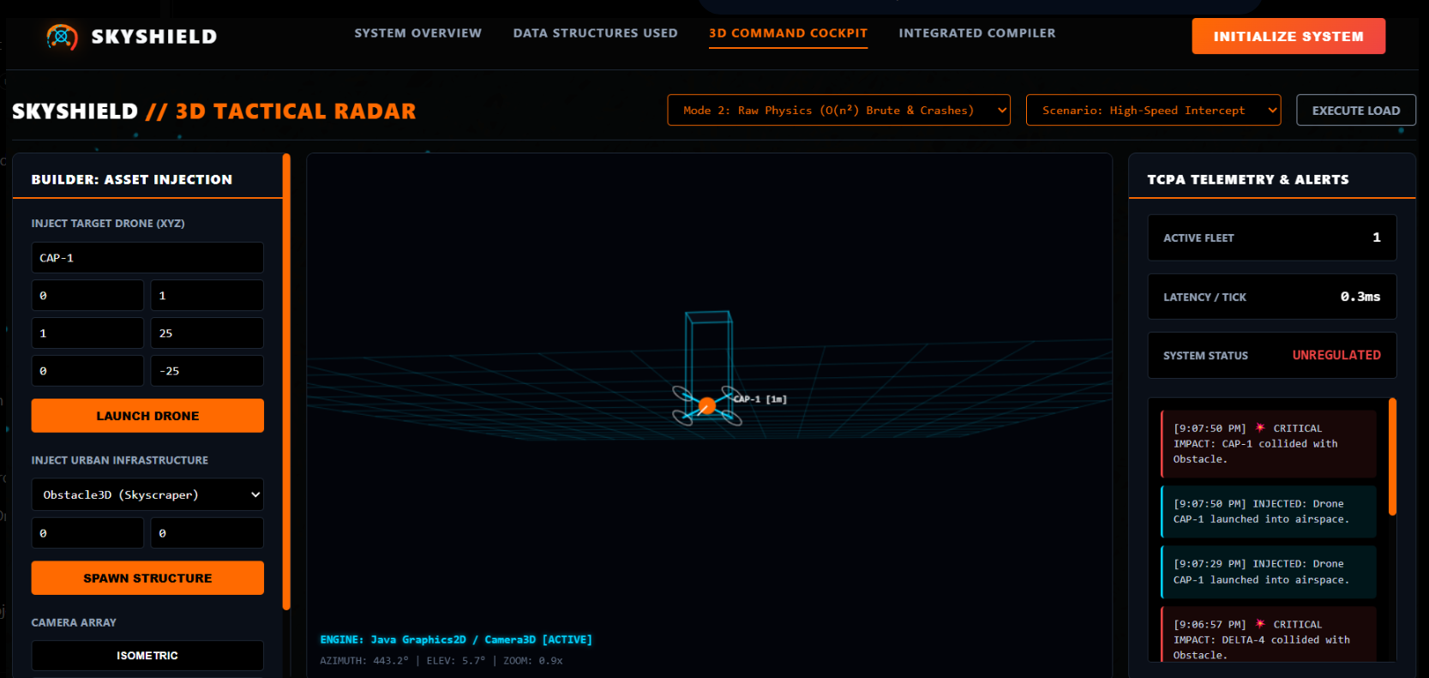
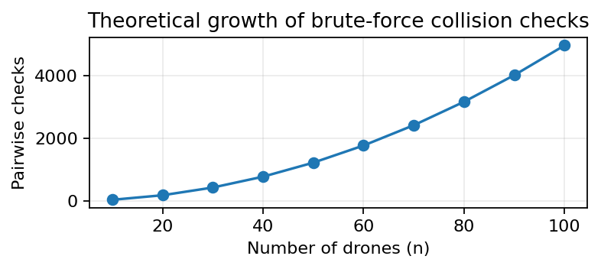
Implementation Results
Functional output, observed interface metrics, processing results, and benchmark availability
OUTPUT SCREENSHOT — 3D TACTICAL RADAR
OBSERVED OUTPUT / METRICS
Active fleet
1 drone
Latency / tick
0.3 ms (UI display)
System status
UNREGULATED
Collision processing
CRITICAL impact alert displayed
Search / processing
Nearest-drone & range-query functions available
Execution benchmark
Not instrumented
Memory usage
Not instrumented
GRAPH — INPUT SIZE / THEORETICAL WORKLOAD
SEARCH / PROCESSING RESULTS
• Collision detection: functional alert shown in the supplied interface.
• No-fly / obstacle monitoring: critical impact state displayed.
• Spatial queries: KD-Tree nearest-neighbor and Quad Tree range-query operations implemented.
• Execution time and memory: no instrumentation in the supplied implementation, so no fabricated values are reported.
REAL-TIME DRONE AIRSPACE MONITORING • DSA-2 CAPSTONE
13

Slide 14
Results Analysis
Interpreting observed results, scalability, effectiveness, and implementation trade-offs
WHAT DO THE RESULTS INDICATE?
HOW DOES PERFORMANCE CHANGE WITH INPUT SIZE?
The prototype successfully performs collision detection, no-fly-zone checks, nearest-drone search, and 2D range queries.
As the number of drones increases, direct pairwise checking grows rapidly, while spatial indexing avoids unnecessary comparisons for localized queries.
THEORETICAL VS OBSERVED PERFORMANCE
HOW EFFECTIVELY DOES THE SELECTED DSA SOLVE THE PROBLEM?
The observed functional behavior follows the expected complexity trends. However, no measured runtime benchmark was collected, so numerical performance claims are not made.
KD-Tree supports 3D nearest-neighbor search, Quad Tree supports 2D range queries, and the Sweep Line approach narrows collision candidates by spatial proximity.
ADVANTAGES OF THE PROPOSED APPROACH
LIMITATIONS OF THE IMPLEMENTATION
Geometry-aware indexing, query-specific data structures, organized drone records, targeted spatial searches, and support for trajectory updates.
KD-Tree construction repeatedly sorts data, the ArrayList-based sweep can degrade to O(n²), and spatial indexes are rebuilt for query operations.
KEY TAKEAWAY: Spatial data structures improve targeted airspace queries, while implementation-level optimization is required for large-scale real-time deployment.
REAL-TIME DRONE AIRSPACE MONITORING • DSA-2 CAPSTONE
14

Slide 15
Conclusion & Future Scope
Conclusion & Future Scope
15
From dynamic records to spatially aware monitoring
From dynamic records to spatially aware monitoring
CONCLUSION
FUTURE SCOPE
• Problem addressed: Real-time detection of drone-to-drone collisions and no-fly-zone violations in 3D airspace.
• DSA used: HashMap, ArrayList, 3D KD-Tree, and 2D Quad Tree.
• Algorithm implemented: Euclidean distance, KD-Tree nearest-neighbor search, Quad Tree range query, and Sweep Line collision detection.
• Major results: Functional drone tracking, trajectory updates, collision alerts, nearest-drone search, range queries, and no-fly-zone detection.
• Overall outcome: A working DSA-based prototype for spatially aware drone collision and airspace monitoring.
• Performance improvements: Optimize collision checking and spatial queries for larger drone populations.
• Scalability: Maintain spatial indexes dynamically instead of rebuilding trees for each query.
• Memory optimization: Reduce duplicate data and improve node/storage management.
• Additional functionality: Add trajectory prediction, adaptive safety margins, conflict resolution, and prioritized alerts.
• Integration with other technologies: Integrate GPS/ADS-B, LiDAR/depth sensors, live telemetry, cloud services, and real-time dashboards.
• Possible alternative algorithms/data structures: Explore R-Trees, Octrees, dynamic KD-Trees, spatial hashing, and optimized sweep-line structures.
OVERALL OUTCOME: DSA-based spatial indexing provides a structured approach to drone collision and airspace monitoring.
REAL-TIME DRONE AIRSPACE MONITORING • DSA-2 CAPSTONE
SKYSHIELD

Slide 16
References
16
Technical resources and project source
RESEARCH PAPERS
CONFERENCE / TECHNICAL PAPERS
[1] Bentley, J. L. (1975). “Multidimensional Binary Search Trees Used for Associative Searching.” Communications of the ACM, 18(9), 509–517. DOI: 10.1145/361002.361007.
[2] Finkel, R. A., & Bentley, J. L. (1974). “Quad Trees: A Data Structure for Retrieval on Composite Keys.” Acta Informatica, 4, 1–9. DOI: 10.1007/BF00288933.
[3] Bentley, J. L., & Ottmann, T. A. (1979). “Algorithms for Reporting and Counting Geometric Intersections.” IEEE Transactions on Computers, C-28(9), 643–647.
[4] Bentley, J. L. (1980). “Multidimensional Divide-and-Conquer.” Communications of the ACM, 23(4), 214–229.
BOOKS
OFFICIAL DOCUMENTATION
[5] de Berg, M., Cheong, O., van Kreveld, M., & Overmars, M. Computational Geometry: Algorithms and Applications. Springer.
[6] Cormen, T. H., Leiserson, C. E., Rivest, R. L., & Stein, C. E. Introduction to Algorithms. MIT Press.
[7] Oracle. Java SE Documentation — Java Collections Framework, HashMap and ArrayList APIs.
[8] OpenJDK / Oracle Java Platform documentation for Java language and runtime APIs.
DATASET / INPUT SOURCES
TECHNICAL RESOURCES
[9] Project-generated synthetic drone telemetry: drone ID, 3D position, velocity and collision radius used for functional testing.
[10] Project-defined no-fly-zone data: zone center and radius used to validate restricted-airspace checks.
[11] Project repository: github.com/Rudheer09/DSA-2-Capstone
[12] Project source implementation: Drone, NoFlyZone, KDTree, QuadTree, SweepLineAlgorithm and DroneSystem.
REAL-TIME DRONE AIRSPACE MONITORING • DSA-2 CAPSTONE
SKYSHIELD

